Slide 1
KnowledgeLink :: A Web-Based Academic Portal for Collaborative Learning and Knowledge Sharing
Supervised By:
Mahmuda Khatun
Assistant Professor
Department of Computer Science & Engineering
Comilla University
Presented By
MD.MEHEDI HASAN
ID: 12108040
Session:2020-21
Department of Computer Science & Engineering
Comilla University
MD.Shoriful Islam
ID: 12108048
Session: 2020-21
Department of Computer Science & Engineering

Slide 2

What is
A Web-based platform for academic collaboration.
Centra Centralize course management, resource sharing, and communication for students, teachers, moderators, and admin
Addresses scattered resources and inefficient workflows in educational institutions.
Illustration of a connected network or a classroom with digital devices.
Use a simple diagram to show the concept of centralization.

Slide 3
Project Overview
A centralized web platform to manage academic resources.
Streamlines collaboration between students, teachers, moderators, and admins.
Role-based features: material uploads, course management, blogs, and announcements.
Built using modern web technologies: Node.js, Express.js, MySQL, JavaScript.

Slide 4
Challenges Addressed
Data Overload
Lack of Centralization
Access Control
Moderation
visuals

Slide 5
Goals Of
Develop a user-friendly web application for academic collaboration.
Intuitive interface for course enrollment and resource access.
Create a user-friendly interface for course enrollment, material access, and blog posting
Implement a MySQL database to manage users, courses, materials, blogs, and announcements.
Provide secure role-based authentication using JWT.

Slide 6
Technology Stack
Backend: Node.js, Express.js (RESTful APIs).
Database: MongoDB
Frontend: Vanilla JavaScript, HTML, CSS.
Tools: JWT (authentication), Multer (file uploads).
Architecture: Client-server model with MVC pattern.

Slide 7
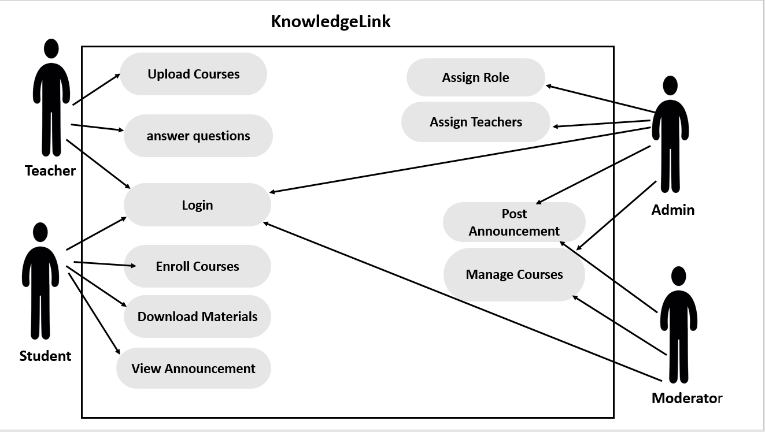
System Design
Use Case Diagram

Slide 8
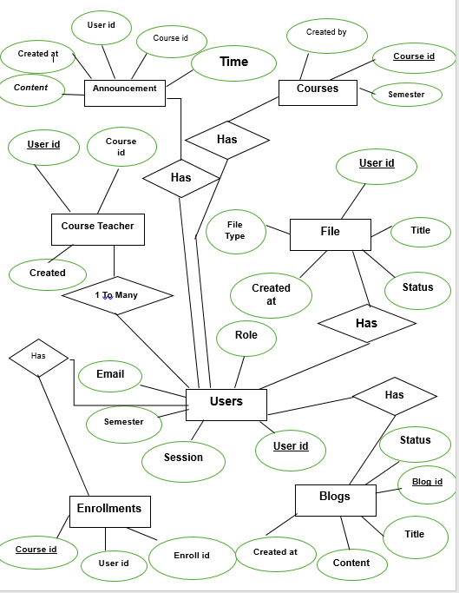
Entity Relationship Diagram

Slide 9
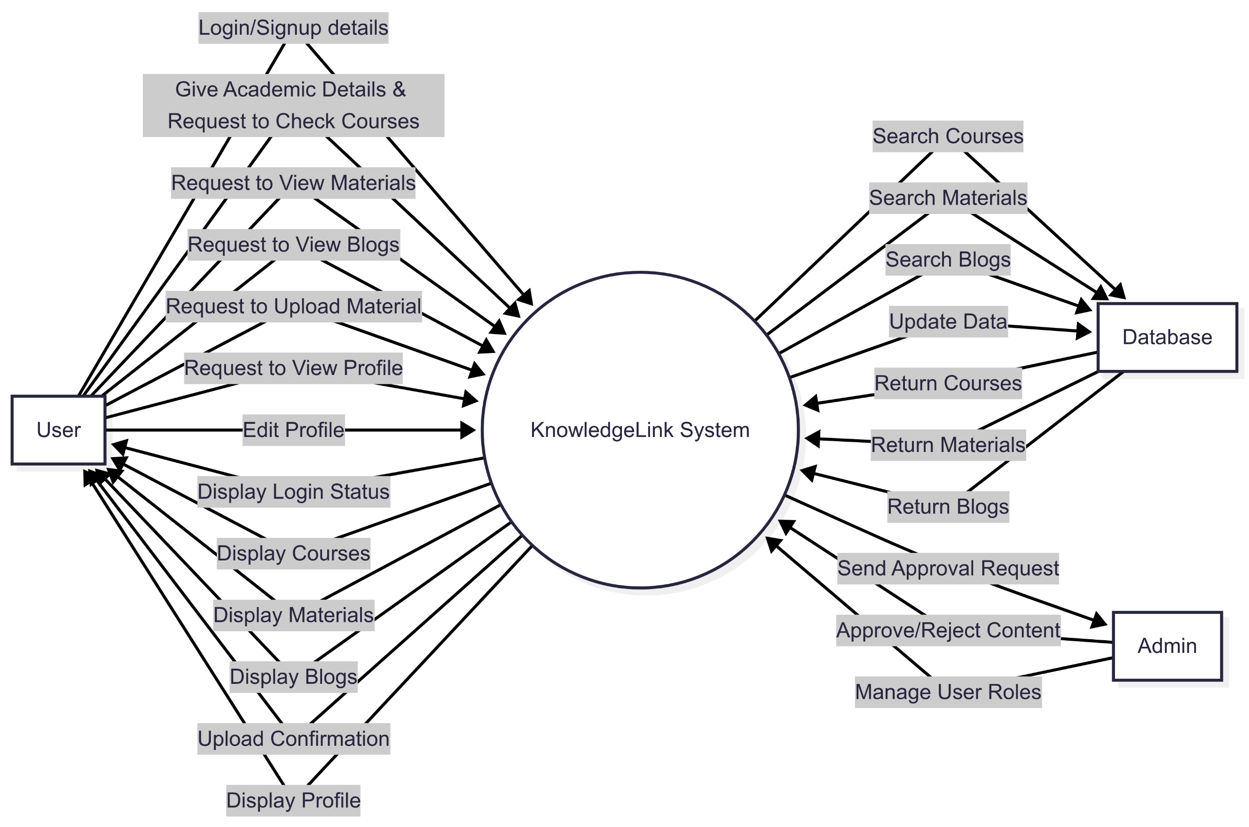
Dataflow Diagram
Fig: Dataflow Diagram Level 0

Slide 10
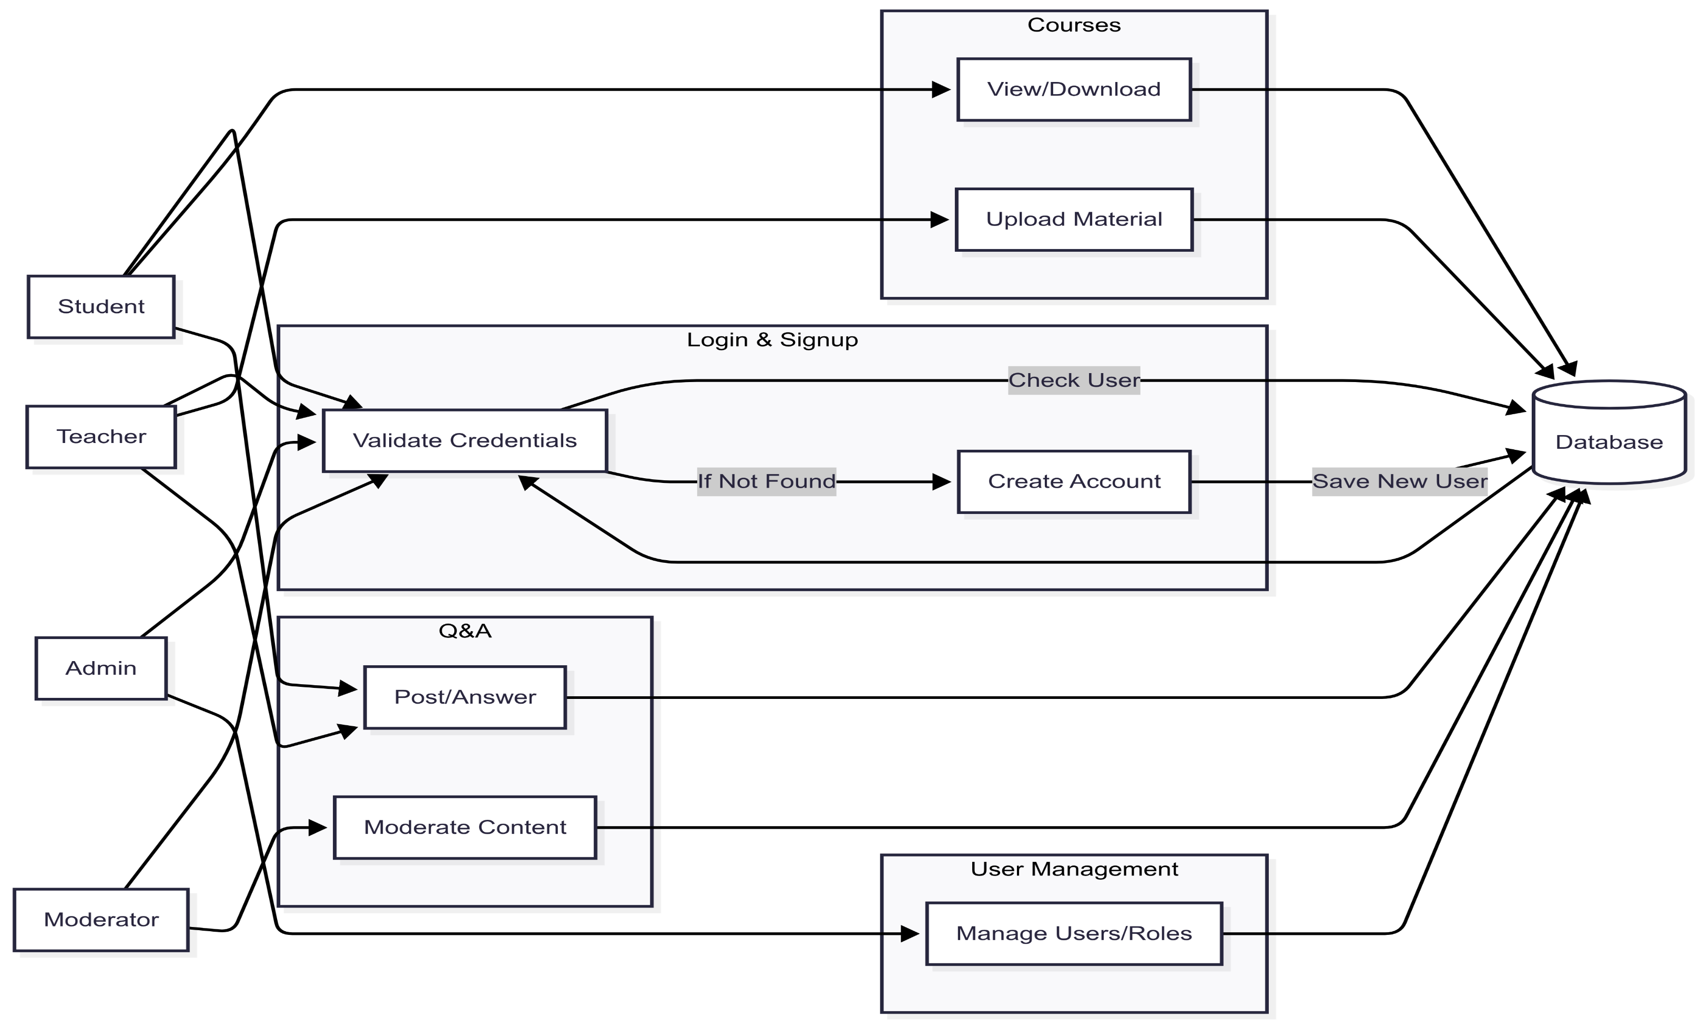
Fig: Dataflow Diagram Level 1

Slide 11
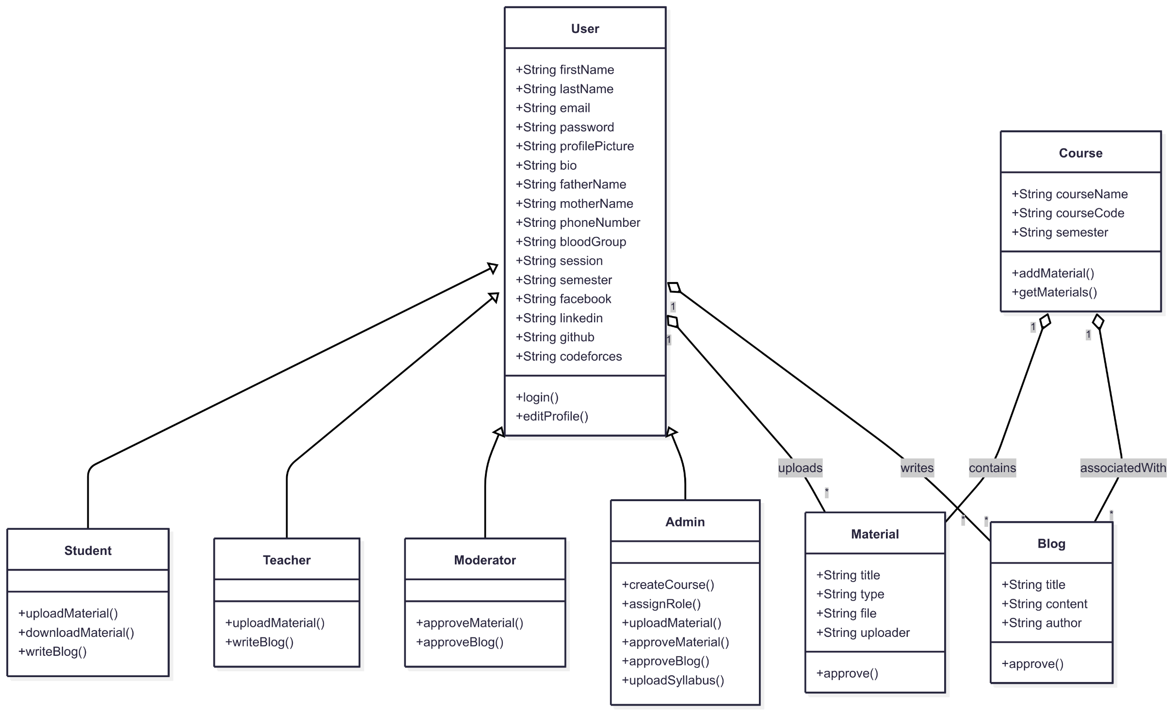
Class Diagram

Slide 12
Core Features
User Roles: Students, Teachers, Moderators, Admins.
Course Management: Create, enroll, and manage courses.
Resource Sharing: Upload/download materials (PDF, PPTX, videos).
Blogs & Announcements: Post and moderate content.
Admin Dashboard: Oversee users, courses, and approvals.

Slide 13
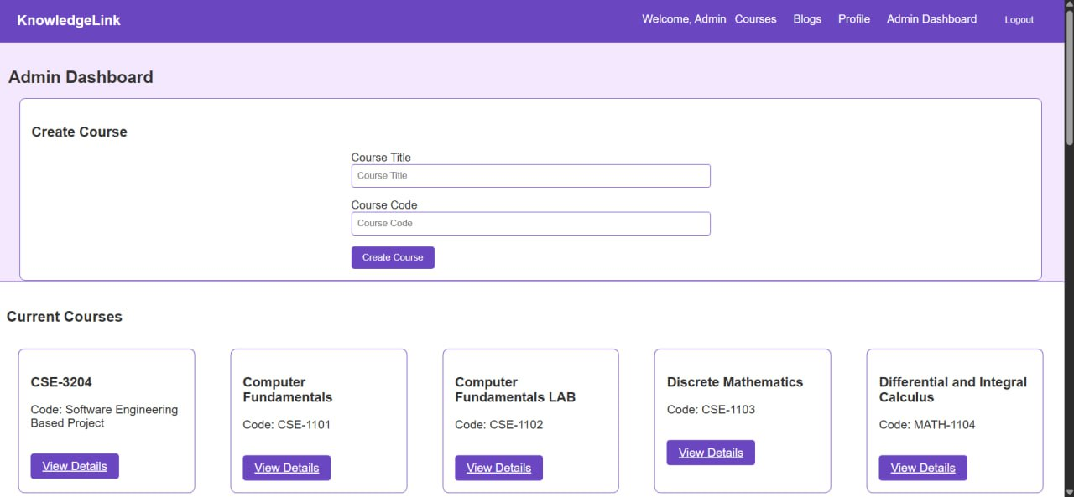
Fig:Admin Dashboard

Slide 14
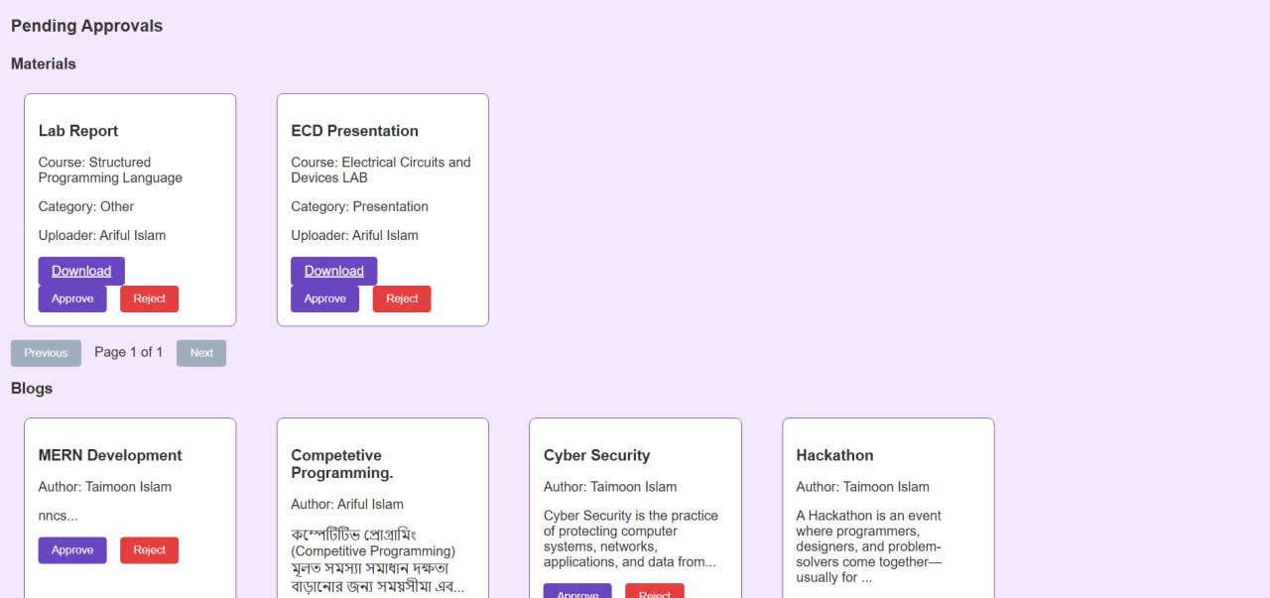
Fig:Admin Dashboard

Slide 15
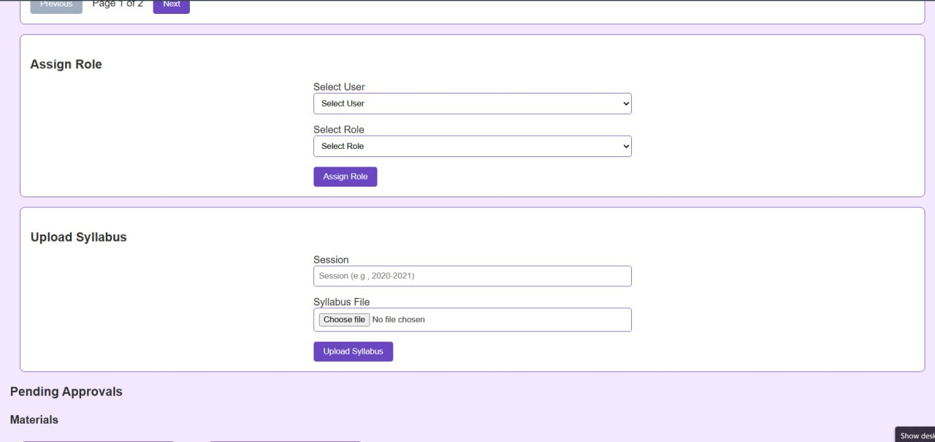
Fig:Admin Dashboard

Slide 16
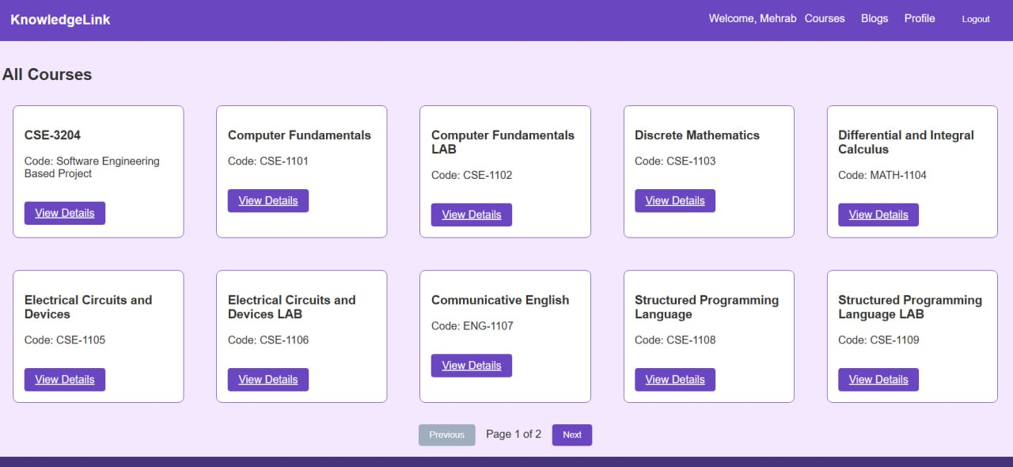
Fig: Available Courses

Slide 17
KnowledgeLink vs. Others
Moddle: Comprehensive but complex; lacks blog moderation.
Google Classroom: Simple but limited role customization.
Built-in content moderation
Lightweight Design.
Flexible role-based access

Slide 18

Current Limitations
Security vulnerabilities
Blog Functionality not fully stable
API and backend Constraints
Frontend limitations
Suboptimal user experience in some areas

Slide 19
Next Steps
Fix blog functionality and enhance UI/UX
User Experience Enhancement
Security and Validation
Integrate scholarship search features.
Enhance UI/UX for scalability.

Slide 20


